Slide 1
PROJECT 24CC3046-P028
Azure Network Security Group
and ASG Rule Rationalisation
Moving from sprawling IP-based rules to a leaner, application-aware NSG design
Replace IP-based rules with Application Security Groups
Reduce total NSG rule count by half

Slide 2
Team Members:
2400090203-Bogesh:
Team lead and Azure architecture(Azure Resourses)
2400090205-Venkatesh:
NSG rules ,priorities and security analysis
2400090219-Lasya:
Configuring Virtual network(Web, App subnets)
2400090220-Mounisha:
IP to ASG mapping ,duplicate rules analysis

Slide 3
CONTEXT
Problem Statement
As Azure environments grow, Network Security Groups accumulate large numbers of rules written against individual IP addresses and CIDR ranges. Rules are added faster than they are retired, so the ruleset stops reflecting the actual application architecture.
01
Replace IP-based rules with ASGs
Group resources by role instead of address.
The result: rulesets that are hard to audit, slow to change safely, and prone to hiding both unnecessary exposure and unintended blocking.
02
Reduce rule count by half
GOAL
Rationalise NSG / ASG rules for a leaner, application-aware, and auditable security posture.
Consolidate and remove redundant rules.
2

Slide 4
USE CASE 1
Replace IP-Based Rules with ASGs
Before:
Allow 10.0.1.4, 10.0.1.5, 10.0.1.9 → port 443
(re-edited every time a VM is added)
Today, NSG rules reference raw IP addresses and ranges. Every new VM,
address change, or scale event forces a manual rule edit — with no link
between a rule and the workload it protects.
Application Security Groups let rules target a logical group (e.g. "Web-Tier") instead of an address. Membership updates automatically as VMs are added or removed — the rule itself never changes.
After:
Allow ASG-Web-Tier → port 443
(VMs join/leave the ASG; rule stays fixed)
OUTCOME
Rules read as intent (“Web ASG may reach App ASG on 443”) instead of address lists, and stay valid as infrastructure scales.
3

Slide 5
USE CASE 1
Overcoming the Bottleneck
BOTTLENECK
While IP-based and ASG-based rules coexist during migration, overlapping rules at different priorities create ambiguous evaluation order — traffic can be blocked or allowed unintentionally.
Rule priority conflicts cause unexpected blocking
APPROACH TO OVERCOME IT
1
Audit and document current rule priorities before touching anything
2
Use Network Watcher's Effective Security Rules to see the resultant, combined behaviour
3
Migrate incrementally: add ASG rules first, validate, then retire the IP-based rules
4
Adopt a priority-gap convention (e.g. steps of 100) so new rules never force renumbering
5
Validate in a staging environment with simulated traffic before touching production
4

Slide 6
USE CASE 2
Reduce Rule Count by Half
Many NSGs carry duplicate or near-duplicate rules — one per IP address doing the same job.
Once workloads are grouped into ASGs, those duplicates collapse into a single rule per group.
Fewer rules means faster reviews, lower risk of stale or conflicting entries, and a rule table that maps cleanly onto the application architecture rather than historical patches.
TARGET
Cut the active NSG rule count by 50% while preserving the same allowed traffic paths.
5

Slide 7
USE CASE 2
Overcoming the Bottleneck
BOTTLENECK
With NSGs applied at both subnet and NIC level, layered inheritance makes it difficult to trace which rule actually governs a given flow — a real risk when consolidating rules.
Effective security rules are hard to reason about
APPROACH TO OVERCOME IT
1
Run Effective Security Rules and IP Flow Verify before and after each consolidation batch
2
Document a rule dependency map covering both subnet- and NIC-level NSGs
3
Consolidate in small batches with a clear rollback plan for each
4
Re-test critical traffic paths after every batch, not just at the end
5
Automate rule documentation so the map stays current as rules change
6

Slide 8
AZURE SERVICES USED
The building blocks behind the rationalisation
1
2
3
Virtual Network
Network Security Groups
Application Security Groups
Hosts the tiered subnets (Web / App / Data) in scope
Enforce inbound/outbound rules per subnet
Group workload NICs by role for rule targeting
4
5
6
Network Watcher
Azure Monitor / Log Analytics
Azure Policy
Captures flow logs and effective security rules
Central store for rule and traffic telemetry
Flags rules that bypass the ASG convention
Azure NSG & ASG Rule Rationalisation
24CC3046-P028

Slide 9
SOLUTION ARCHITECTURE
Tiered subnets, each guarded by an NSG and ASGs
VIRTUAL NETWORK
Web Subnet
App Subnet
Users
NSG-Web
NSG-App
NSG-Data
ASG-Web-Tier
ASG-App-Tier
VM · VM · VM
VM · VM · VM
Azure NSG & ASG Rule Rationalisation
24CC3046-P028

Slide 10
CHALLENGES FACED & SOLUTIONS
What made this hard, and how it was handled
1
CHALLENGE
SOLUTION
Rule priority conflicts caused unexpected blocking when ASG rules were introduced alongside legacy IP rules.
Reserved priority bands per rule category, validated with Effective Security Rules before and after each change, migrated one NSG at a time.
2
CHALLENGE
SOLUTION
Effective security rules were hard to reason about once NSGs, subnets, and ASGs all contributed to a resource's exposure.
Baselined the real effective ruleset per NIC first, then consolidated duplicates into ASG-scoped rules and cross-checked against flow logs.
Azure NSG & ASG Rule Rationalisation
24CC3046-P028

Slide 11
SUMMARY
From Rule Sprawl to a Rationalised NSG Design
Assess
current rules
Group into
ASGs
Migrate &
validate
Consolidate
rules
Monitor &
prevent sprawl
Outcome: fewer, application-aware, auditable NSG rules — cutting operational overhead while strengthening the network security posture.
7

Slide 12
FUTURE ENHANCEMENTS
Where this goes next
Enforce the ASG-only convention automatically via Azure Policy across subscriptions
1
2
Template the tiered NSG/ASG pattern in Bicep/ARM for new environments
3
Extend rule rationalisation to Azure Firewall policies for hub-and-spoke topologies
4
Add automated drift detection to flag manually added IP-based rules
Azure NSG & ASG Rule Rationalisation
24CC3046-P028

Slide 13
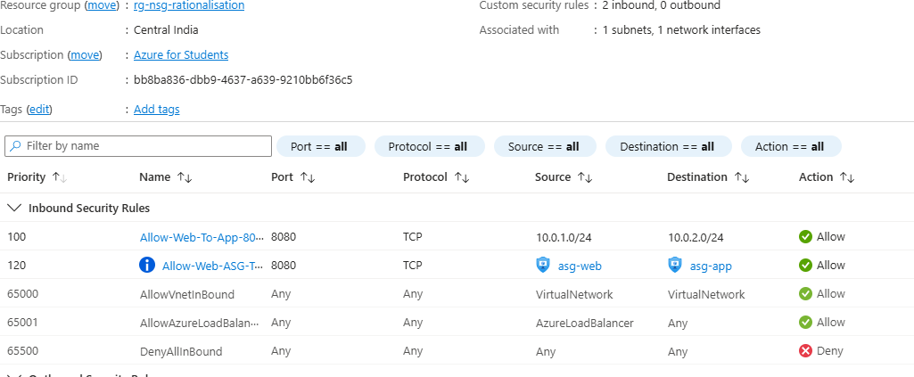

Slide 14
